Slide 1
PASS: Physically-Aware Secure Software Execution
PIs: Mark Tehranipoor (tehranipoor@ufl.edu),
Farimah Farahmandi (ffarahmandi@ufl.edu)

Slide 2
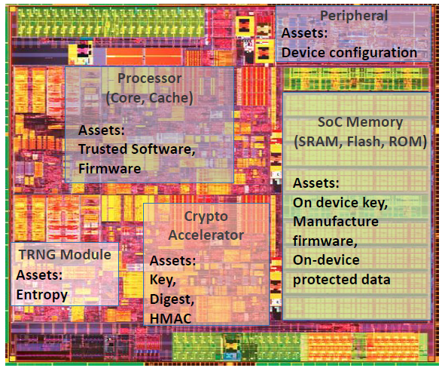
Problem Statement
Problem: protect assets
On-device keys (crypto/obfuscation)
Manufacturer firmware
Application software
On-device sensitive data, etc.
Software running on vulnerable circuits are not secure
Software executed in SoCs, processors, IoT devices, and smartphones is susceptible to both cyber attacks and hardware attacks
Physical attack targets the implementations, bypassing upper-level protections; it’s a powerful attack type compromising the confidentiality, integrity, and availability of modern chips
Software developers and compilers are unaware of physical attacks (fault injection, side channel, data extraction, etc.)
The only existing physical modeling in compilers is based on unrealistic software-based predictions
To solve this: since the cost of redesigning fabricated chips is extremely high, hardening software/firmware against physical vulnerabilities would be a recommended and less costly approach.
Source: Intel
Notes:
Modern software running on vulnerable circuits is vulnerable to both cyber and hardware attacks. Existing protections against cyberattacks are widely integrated across the software standardization, development, and compilation cycle, however, physical attacks such as fault-injection and side-channel attacks directly target hardware implementations. These attacks could bypass upper-level protections and compromise the confidentiality, integrity, and availability of modern chips.
Unfortunately, current software developers and compilers lack information on potential hardware vulnerabilities. And because the vulnerable hardware has already been fabricated and it’s extremely costly to redesign them, hardening software against physical vulnerabilities would be a recommended approach.

Slide 3
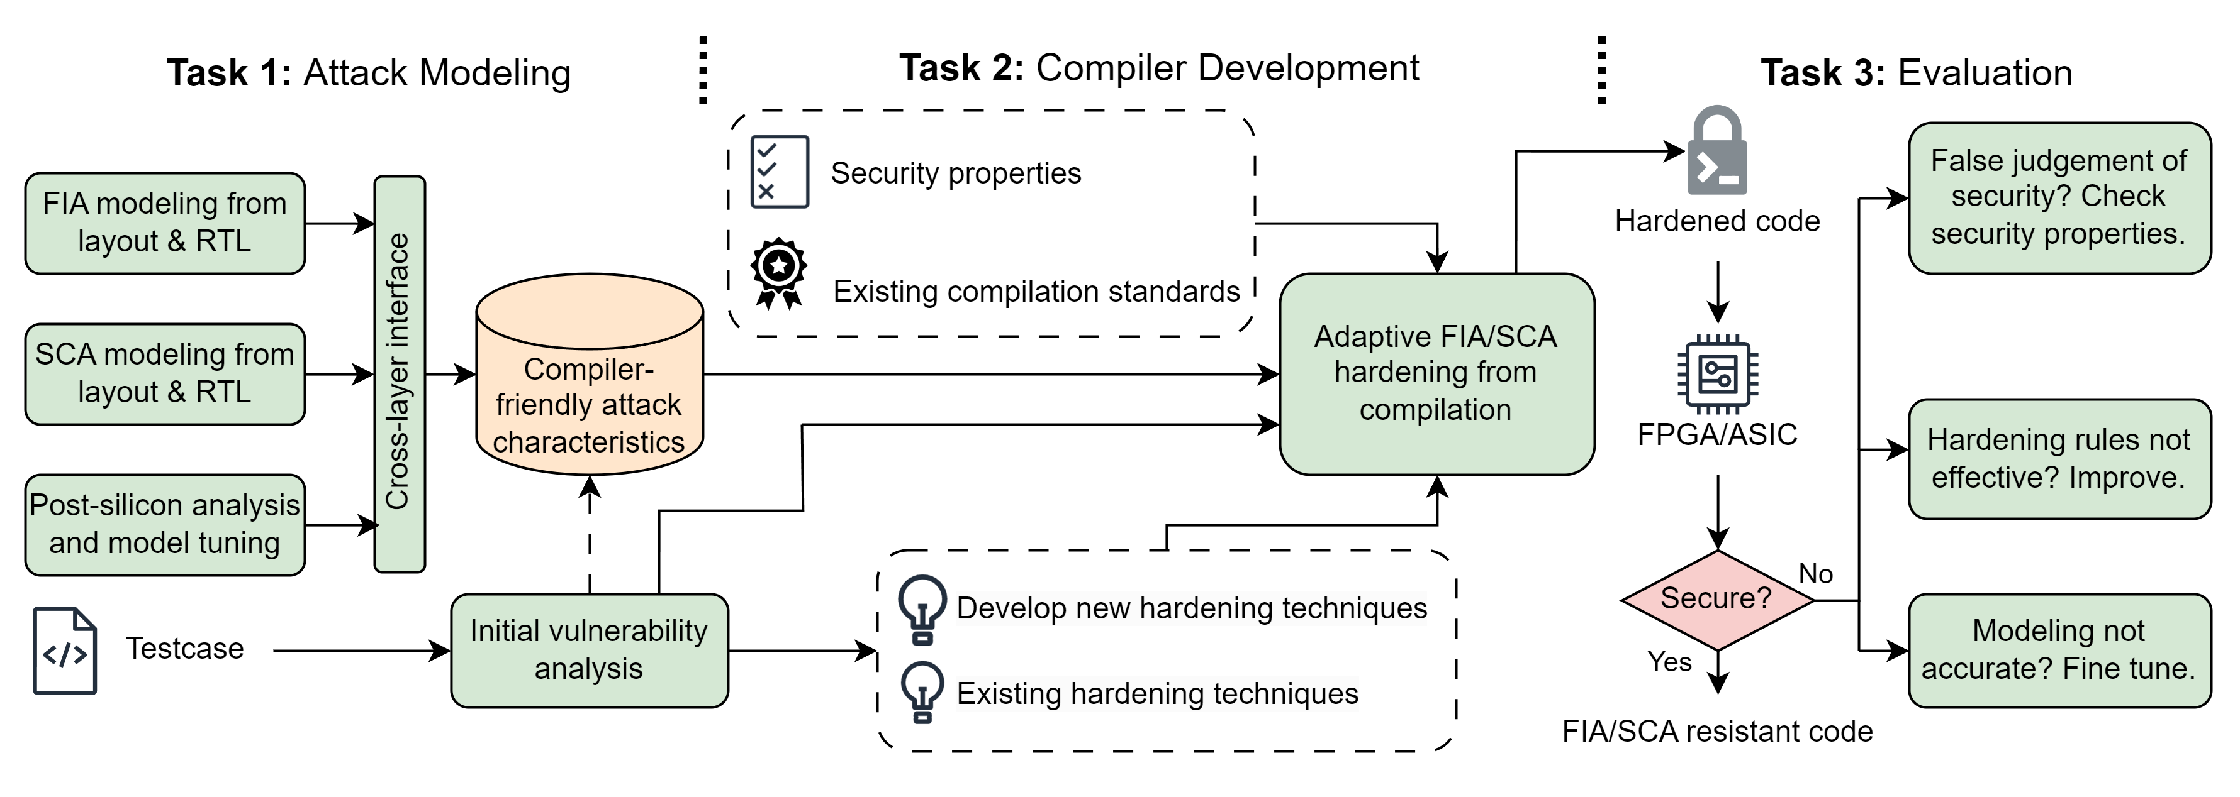
Objective and Tasks
Objective: We propose PASS: a novel, cost-effective, scalable, and adoptable approach for addressing physical threats as many as possible at the software compilation stage.
Task 1: a comprehensive modeling methodology for existing physical attack techniques
Task 2: guided by attack models, we develop and apply software hardening techniques against physical vulnerabilities
Task 3: an extensive evaluation of the PASS flow on SoCs implemented on FPGAs
Overview of PASS flow: physically-aware secure software execution
Notes:
We propose PASS: a novel, cost-effective, scalable, and adoptable approach for addressing physical threats at the software compilation stage.
Task 1: Attack Modeling
We assume one or both of the following steps are performed first:
Physical attacks are modeled based on hardware characteristics at the SPICE/layout-level
Performing post-silicon physical attacks/test on the chip/SoC running the software. If the chip passes the security test, no further action is needed. When the chip fails the test, the collected data and response will help validate and fine-tune the attack models.
Task 2: Compiler Development
We use security properties to define security-sensitive scenarios, and develop a database for hardening techniques.
The attack models’ output, in the form of analog variations, will facilitate establishing the sense of attack criticalities and feasibilities under given attack scenarios, thereby informing the software compiler to avoid such attacks.
Task 3: Evaluation
We perform post-silicon validations on the hardened software. The results will help broaden the hardening technique database, modeling accuracy, etc., so this iterative flow will address physical threats on software as many as possible.

Slide 4
Deliverables
Year 1 (1/1/25-12/31/2025)
Q1-3. SPICE-level and layout-level modeling of the physical characteristics of fault-injection and side-channel attacks;
Q4. Post-silicon attack test on chip/SoC, perform vulnerability analysis of software executions, improve the attack models.
Year 2 (1/1/2026-12/31/2026)
Q1. Investigation and development of physically-aware hardening techniques;
Q2. Developing executable security properties and LUT/ML-based model interfaces to guide hardening strategies.
Q3-4. Integration of hardening techniques into software compilation in the form of GCC plug-in/LLVM/Clang;
Year 3 (1/1/2027-12/31/2027)
Q1-2. Extensive validation of the PASS flow on FPGAs with the iterative test of hardened software compilations;
Q3-4. Broadening the attack scenarios by including more security properties, and fine-tuning of physical attack models.
 | Year 1 |  | Year 2 |  | Year 3
Task 1: Attack Modeling
Task 2: Compiler Development
Task 3: Evaluation
Notes:
This is a 3-year project, we aim to deliver tools and methodologies through the process of this project.
Year 1: We develop attack models from one of, or both of the pre-silicon attack simulations and post-silicon tests.
Year 2: We plan to deliver the compilers integrated with software hardening techniques, the hardening strategies are guided by attack models and testable for given security properties.
Year 3: We aim to deliver both the completed hardening methodology and hardened software validated on FPGAs.

